Slide 1

Stock Price Prediction using News Headlines
Syed Mustafa Hassan
Alok Mishra
Juhi Chadha

Slide 2



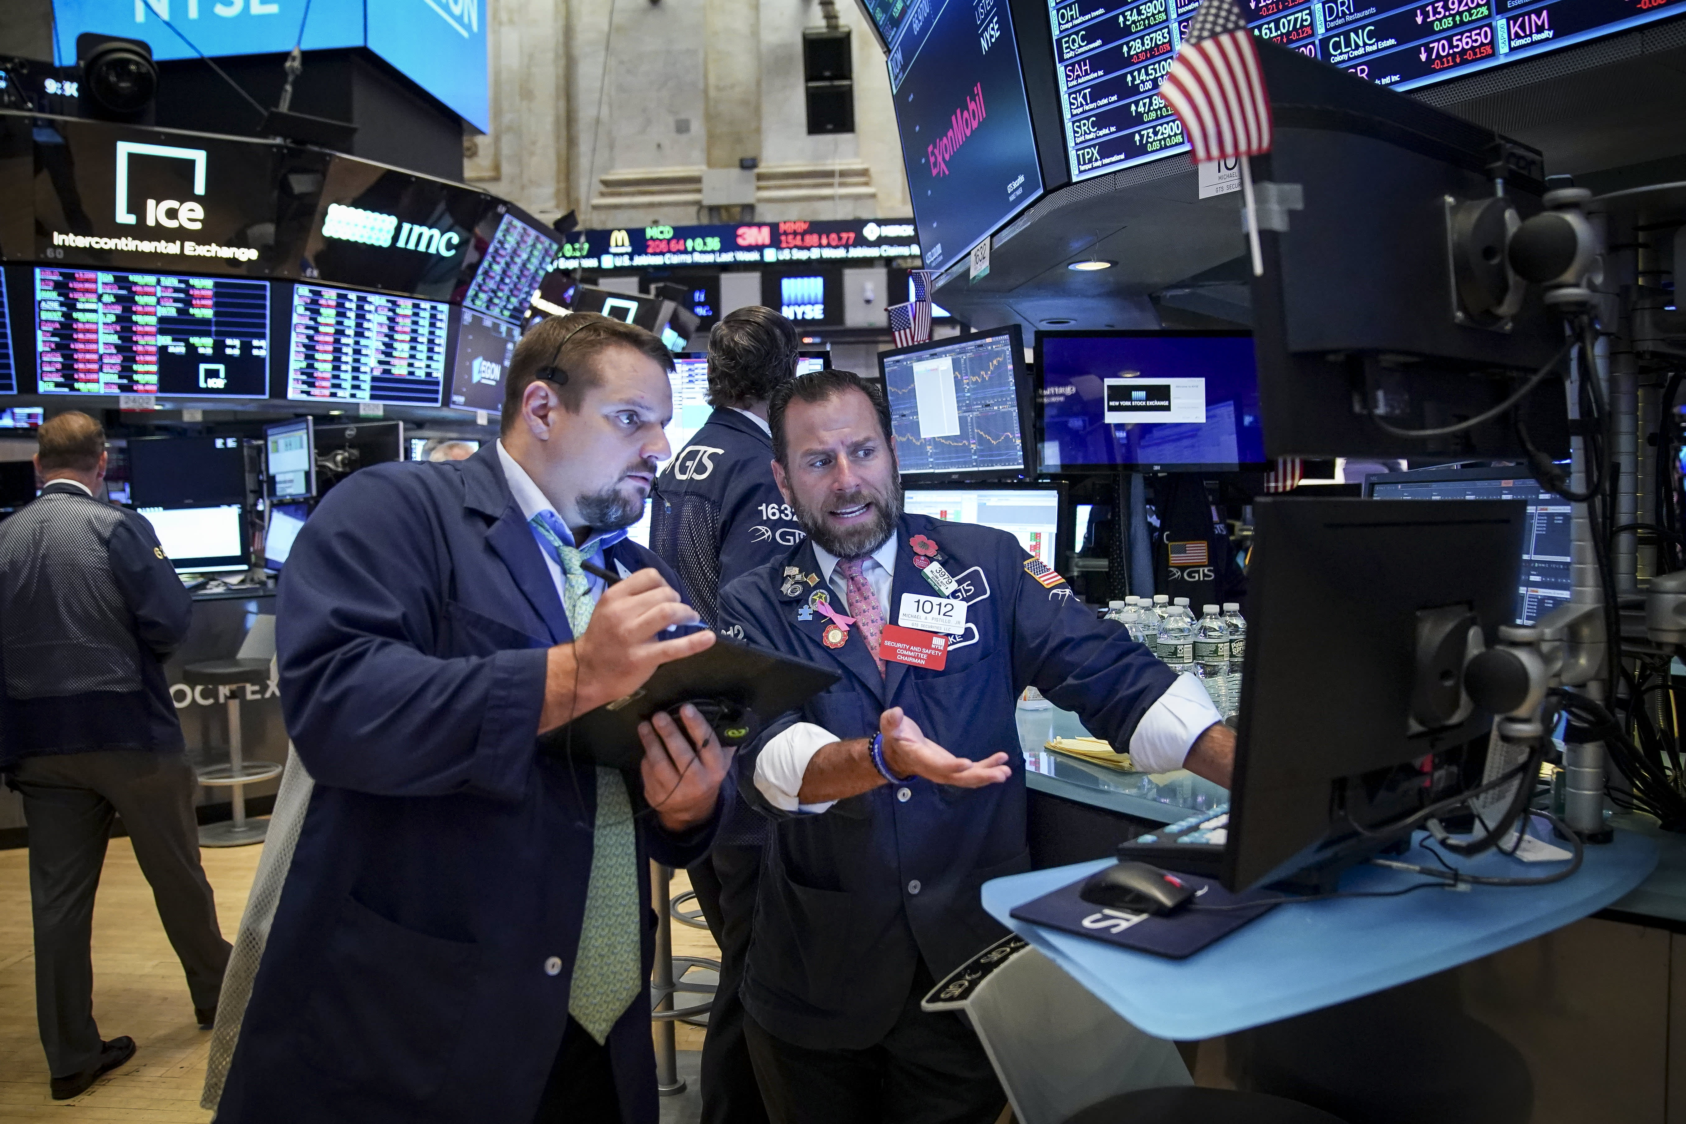

Introduction
Stock prices are a key indicator of market performance and are closely watched by investors, traders, and analysts.
Predicting the direction of stock prices is a complex task that requires the analysis of multiple factors.
News headlines have been shown to impact stock prices and can have a significant influence on market trends.
In this project, we will explore the process of using news headlines to predict stock prices using deep learning.
Notes:
Dataset
We are going to use two datasets:
First one is a dataset that contains the column Date and News. It contains News headlines for each day starting from 2008 till 2016. In total it has 73608 rows.
Second one is a dataset that contains the column Date,Open,High,Low,Close,Volumeand Adj Close. It contains daily Stocks information for Dow Jones which contains 30 most prominent companies in the United States, starting from 2008 till 2016.

Slide 3
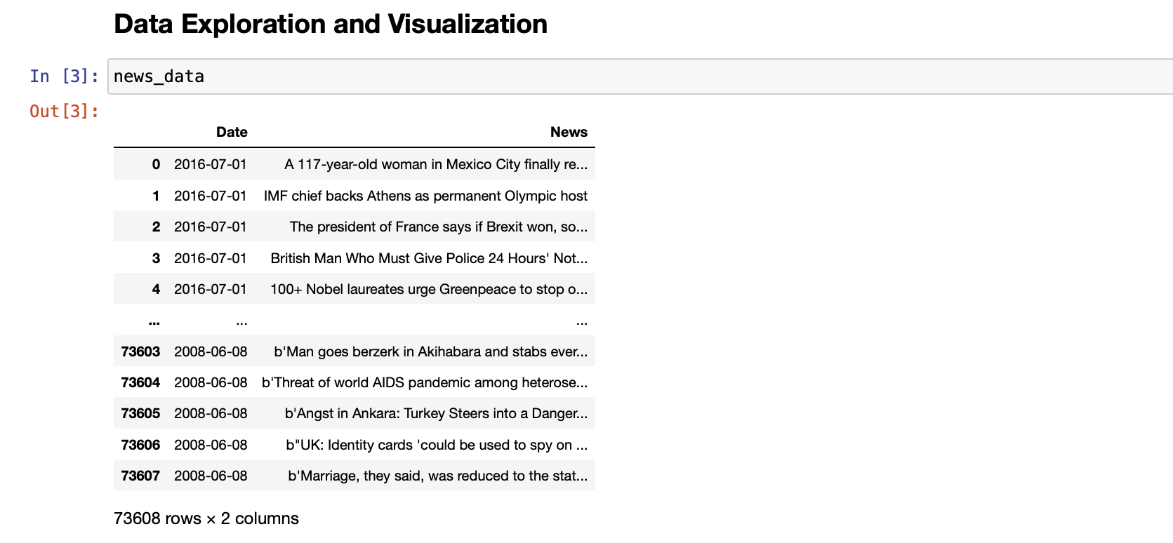
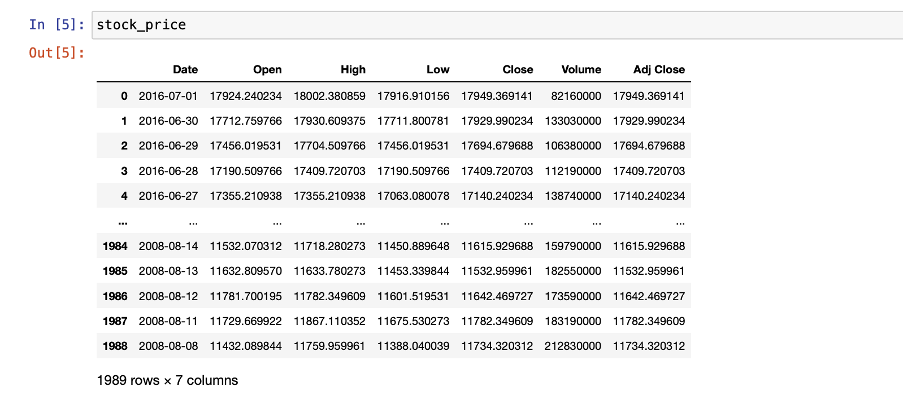
Dataset
The datasets consists of two channels of data:​
​
News data: Historical news headlines from Reddit WorldNews Channel (/r/worldnews). They are ranked by reddit users' votes, and only the top 25 headlines are considered for a single date.​ Observations: 73608 (Range: 2008-06-08 to 2016-07-01)​
Stock data: Dow Jones Industrial Average (DJIA) is used to "prove the concept".​ (Range: 2008-08-08 to 2016-07-01) Observations: 1989
Sun, J. (2016, August). Daily News for Stock Market Prediction, Version 1. Retrieved 04/10/2023 from https://www.kaggle.com/aaron7sun/stocknews.
Notes:
Importing Dataset
We are going to use two datasets:
First one is a dataset that contains the column Date and News. It contains News headlines for each day starting from 2008 till 2016. In total it has 73608 rows.
Second one is a dataset that contains the column Date,Open,High,Low,Close,Volumeand Adj Close. It contains daily Stocks information for Dow Jones which contains 30 most prominent companies in the United States, starting from 2008 till 2016.

Slide 4
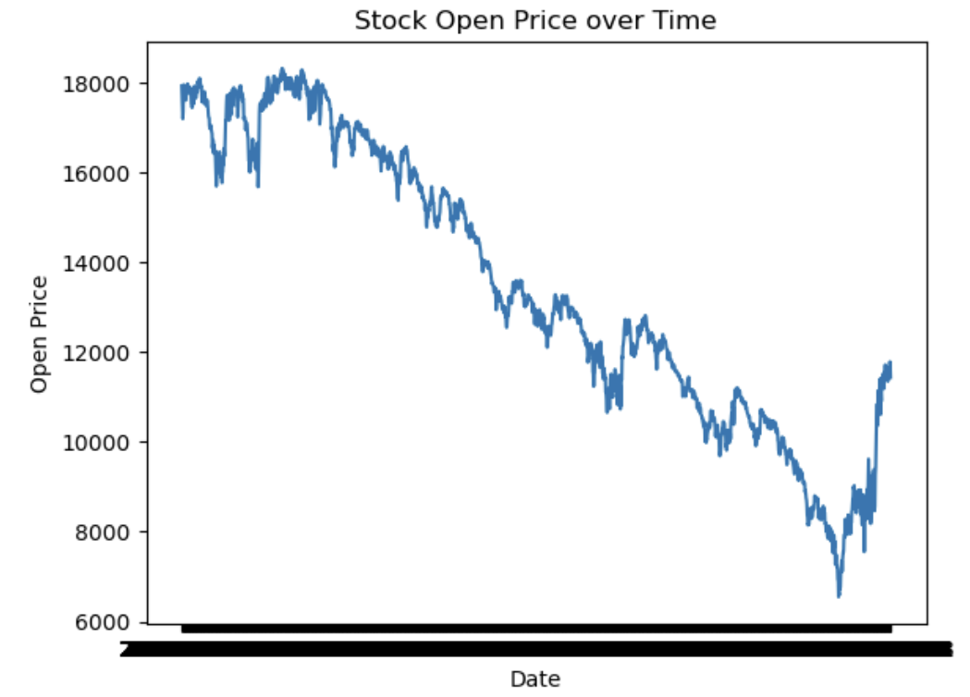
Business Problem
Our goal is to predict the future direction and magnitude of changes in stock prices based on news headlines. This will help investors and traders make more informed investment decisions and potentially increase their returns.​

Slide 5

Data Preprocessing
Removal of extra dates from the News dataset​
Removal of extra columns from the Price dataset​
Taking first difference of open price of the stock ​
Removal of Null values​
Combination of both the datasets that contains Price and News headlines information.​
Normalizing the Market Opening Price.​
Text Preprocessing: removing Stopwords, Contractions, making text lowercase, removing extra white spaces and punctuations​
Defining a Vocabulary by using a Counter, which is a dictionary mapping of words and their counts that allow us to easily update and query.

Slide 6
Time Series Forecasting
Key Considerations in Selecting and Evaluating Time Series Models for Stock Price Prediction:
Stationarity: Stationarity is a critical assumption in time series modeling. A stationary time series has a constant mean and variance over time, making it easier to model and forecast accurately.

Slide 7
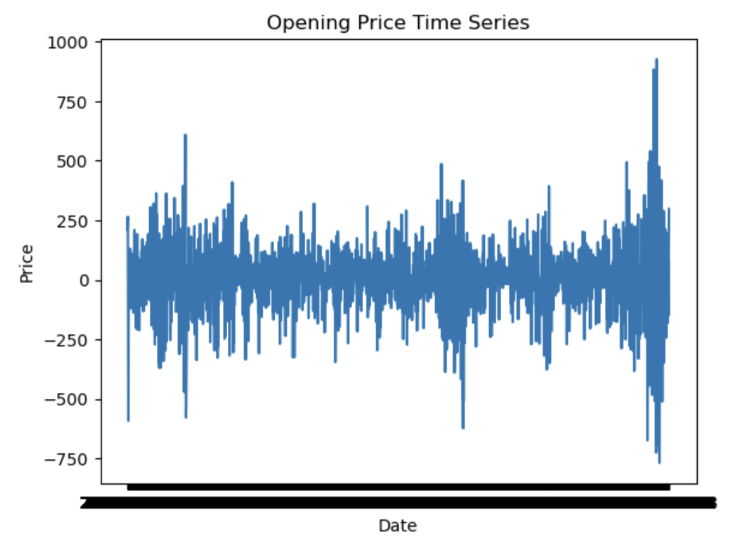
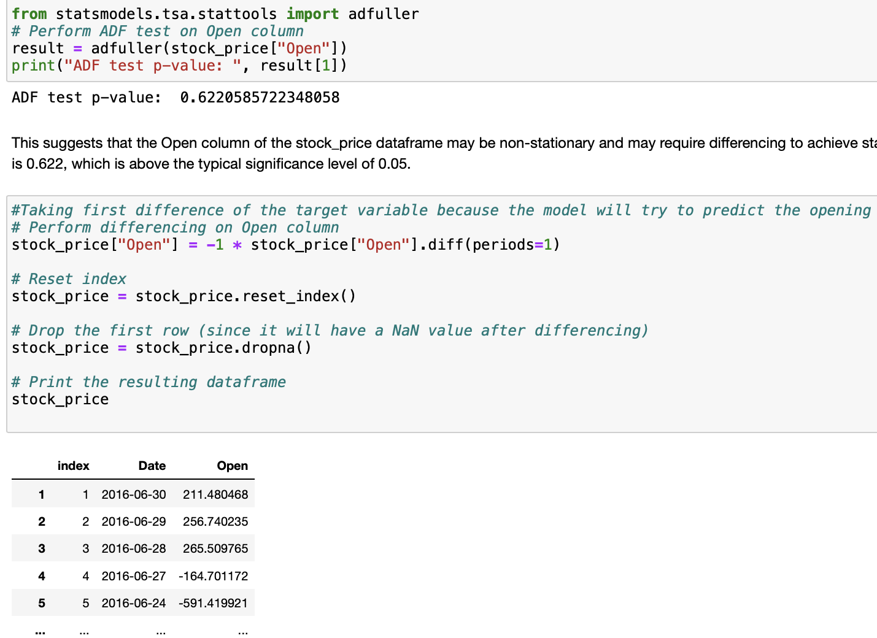
Augmented Dickey-Fuller (ADF) test
To test whether differencing is necessary, the Augmented Dickey-Fuller (ADF) test can be used to check the stationarity of the time series.​
Null hypothesis (Ho): The time series has a unit root, and is therefore non-stationary.​
Alternative hypothesis (Ha): The time series is stationary.​
If the p-value obtained from the test is below the chosen significance level (such as 0.05), the null hypothesis can be rejected and it can be concluded that the time series is stationary. Conversely, if the p-value is above the significance level, the null hypothesis cannot be rejected, and it is concluded that the time series is non-stationary.

Slide 8

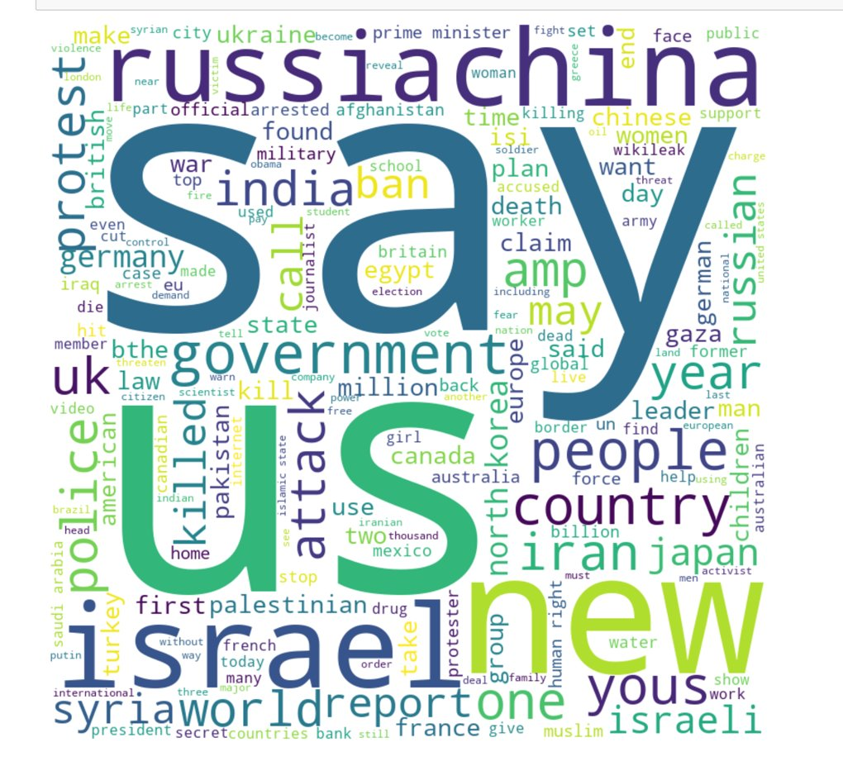

Word Cloud

Slide 9
Text Cleaning steps and packages used
Total number of words in headlines: 591209
Total number of UNKs in headlines: 15191
Percent of words that are UNK:2.570%
Contraction
@ action: to expand the words can't to cannot, I’m to I am
Clean text
@ actions: remove extra spaces, stop words punctuations
Word Vocab
@ to define word vacabulary
Word Embedding
We used Stanford Pre-trained word vectors. Now we are going to use GloVe embedding to initialize the weight for each word

Slide 10
Model Performance Evaluation Metrics
MAPE/MSE/MAE
Generalizability
Notes:
It’s a regression problem

Slide 11
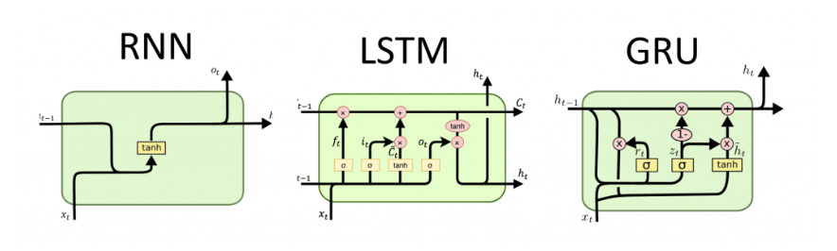
CNN, RNN: LSTM and GRU – High Level Architecture

Slide 12
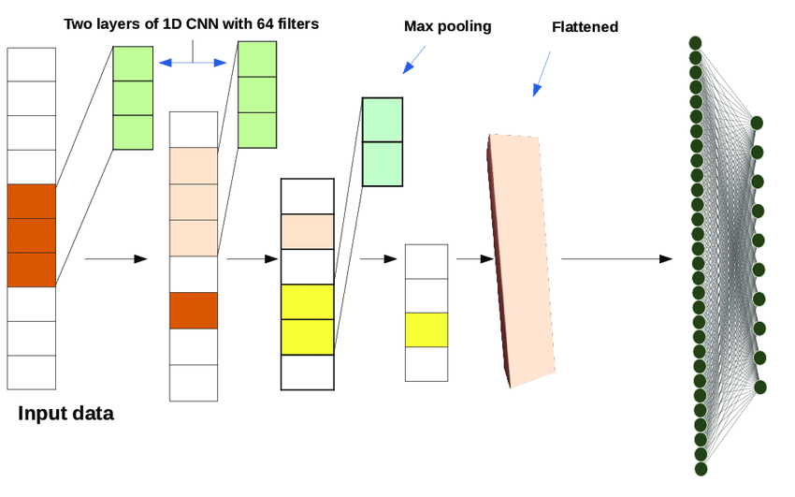
CNN – High Level Architecture
1 D Convolutional Neural Networks used as baseline model

Slide 13
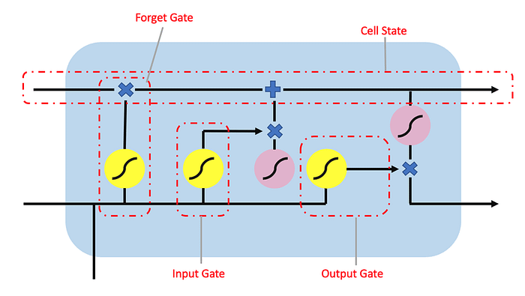
LSTM – High Level Architecture

Slide 14
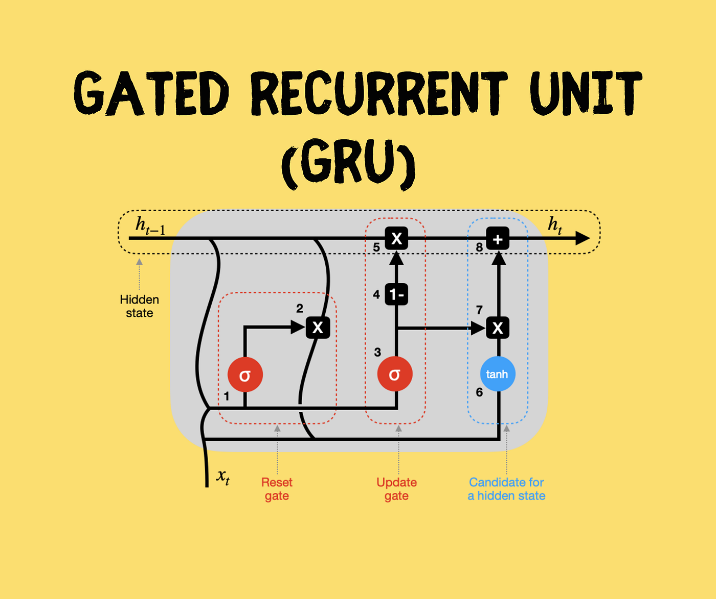
GRU – High Level Architecture

Slide 15
Hybrid
BiD-LSTM
1D CNN
GRU
BiD-LSTM
Hybrid – LSTM + GRU
GRU
CNN
Progression of Model /What we Learn? and /How we come up with our Best Model?

Slide 16
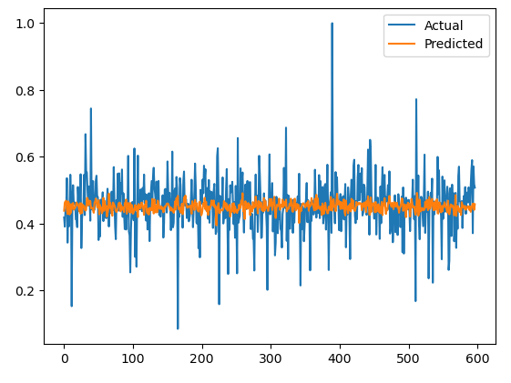
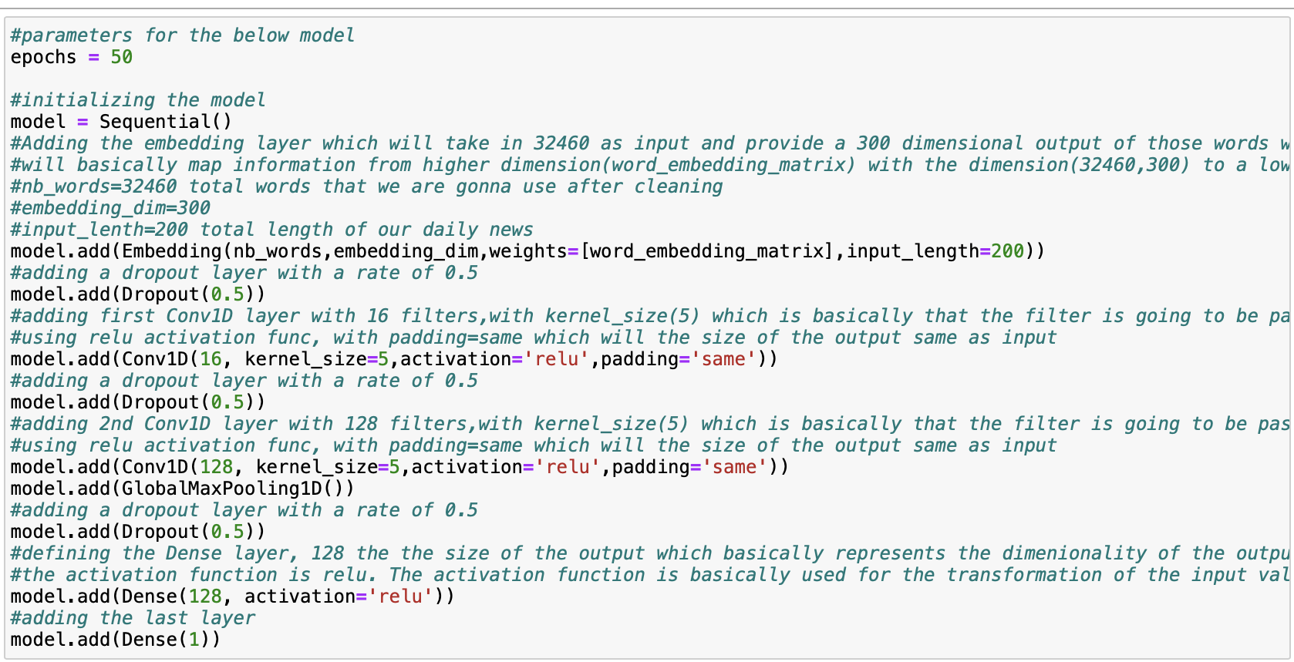
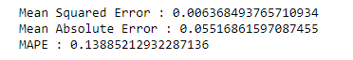
1D CNN Snippet of code
Baseline Model
1D CNN Model Performance

Slide 17
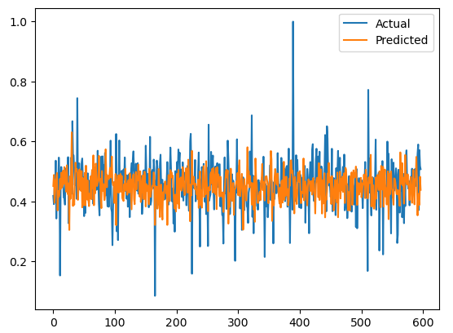
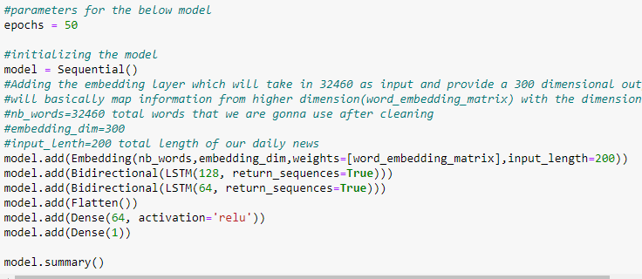
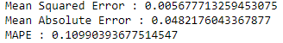
Bidirectional LSTM snippet of code
Bidirectional LSTM model performance

Slide 18
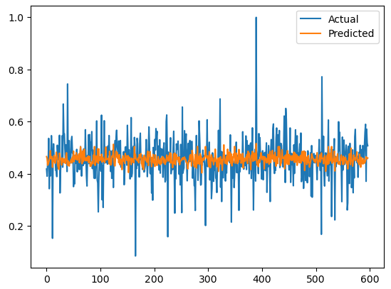
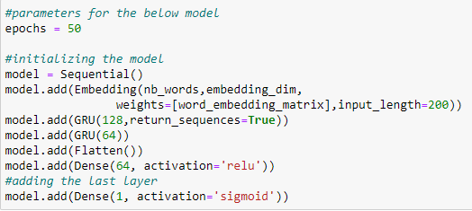
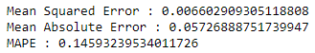
GRU Snippet of Code
GRU Model Performance

Slide 19
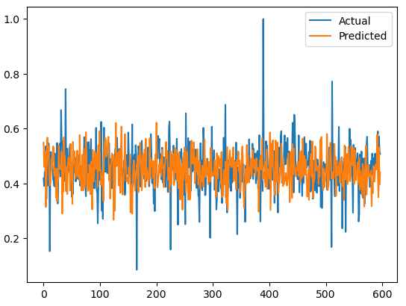
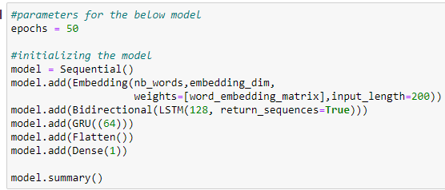
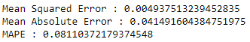
Hybrid Model(LSTM+GRU) snippet of code
Hybrid Model(LSTM+GRU)
Model Performance

Slide 20
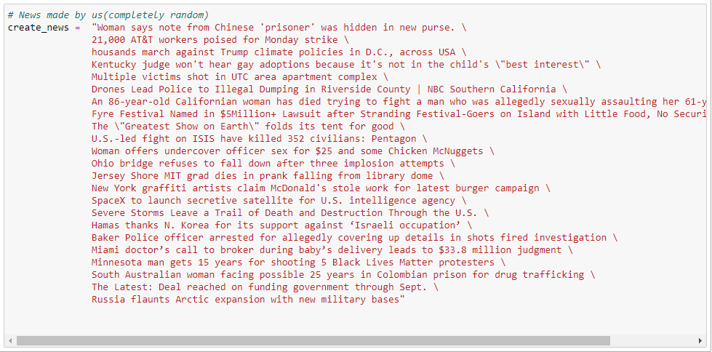
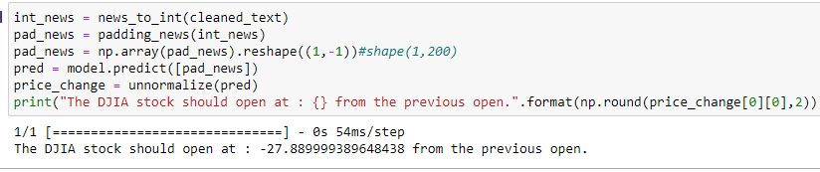
Model Predictions

Slide 21
Overall best performance is by the model containing layer Bidirectional LSTM and GRU

Slide 22


Conclusion
Predicting stock market price movements is challenging for investors due to the unpredictable and volatile nature of the market.​
Automatic techniques for forecasting price movements are crucial for data enthusiasts to make informed investment decisions.​
Traditional statistical models have shown poor performance due to the random nature of stock prices.​
A novel hybrid deep learning model combining bidirectional long short-term memory (Bi-LSTM) and gated recurrent unit (GRU) networks was proposed to improve accuracy.​
Individual models, including LSTM, Bi-LSTM, GRU, and 1D CNN algorithms, were implemented and compared with the proposed hybrid model.​
The hybrid Bi-LSTM-GRU model outperformed the individual models in terms of MSE, MAE, and MAPE metrics.​

Slide 23
Way forward
The unpredictability of financial information makes predicting stock movements a challenging task that has garnered interest from both academia and industry.​
Adding exogeneous variables like employment rate, inflation can help to pick up spikes.
Further research could explore architectural modifications, such as the implementation of transformers, BERT, and transfer learning techniques.​
​

Slide 24
References
Karim M, Foysal M and Das S. (2023). Stock Price Prediction Using Bi-LSTM and GRU-Based Hybrid Deep Learning Approach. Proceedings of Third Doctoral Symposium on Computational Intelligence. 10.1007/978-981-19-3148-2_60. (701-711).​
Y. Wang, D. Seyler, S. K. K. Santu and C. Zhai, "A study of feature construction for text-based forecasting of time series variables", Proceedings of the 2017 ACM on Conference on Information and Knowledge Management ser. CIKM ‘17, pp. 2347-2350, 2017, [online] Available: http://doi.acm.org/10.1145/3132847.3133109.​

Slide 25

Thank You

